Slide 1
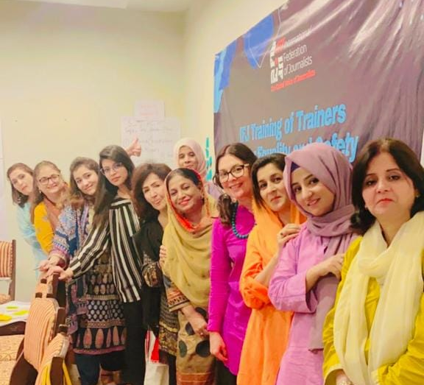
GENDER SNAPSHOT PAKISTAN
2013-2024

Slide 2
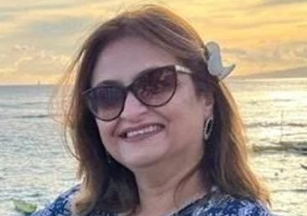
Short Introduction
CONTACT ME
X: @raiseqalam Instagram: lubnajnaqvi
LinkedIn: Lubna Jerar
Facebook: Lubna Jerar Naqvi
Follow WMFP on Facebook; Instagram and X

Slide 3
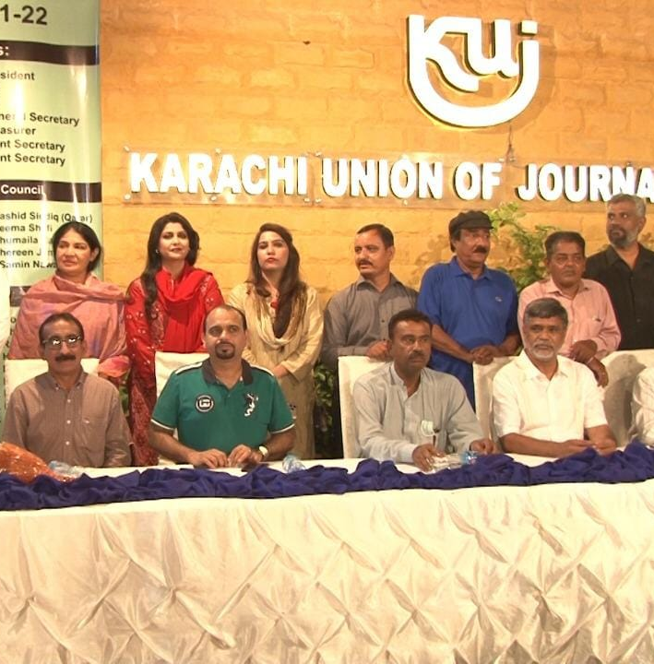
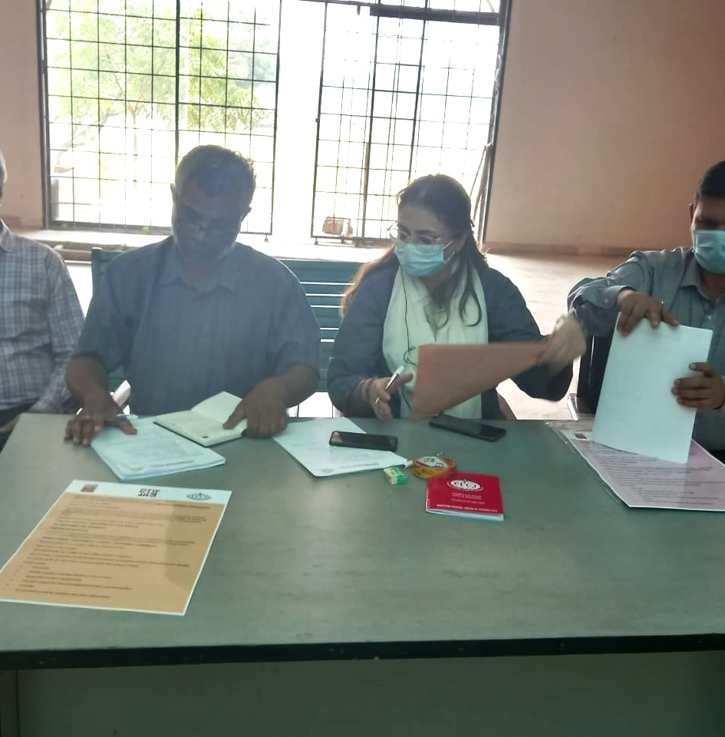
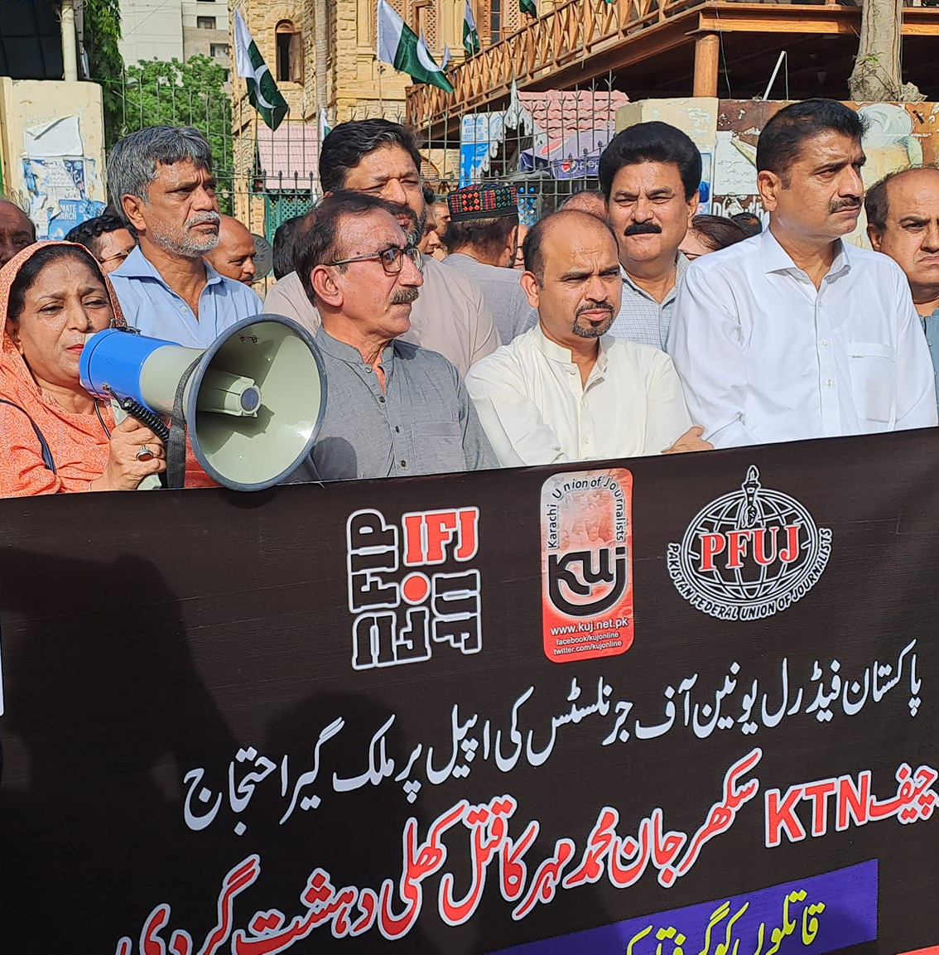
Pakistan Federal Union of Journalists (PFUJ) 2013-2024
PFUJ increased women’s leadership and members by 20%, increasing inclusivity in decision-making
First Female Vice President of the Pakistan Federal Union of Journalists (PFUJ)
First Female Vice President of the Karachi Union of Journalists (KUJ)

Slide 4
IFJ-AP ACTIVITIES IN PAKISTAN 2021-2024

Slide 5
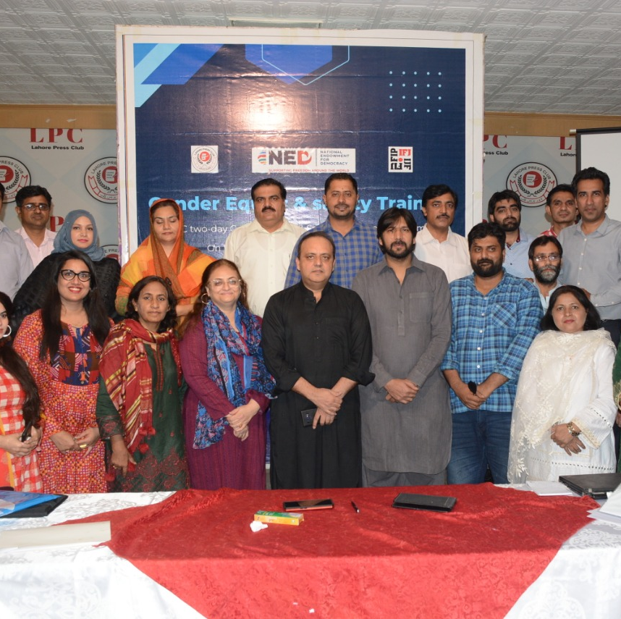
2021
IFJ-AP project in Pakistan is funded by the National Endowment for Democracy (NOW). Under the gender component of this project, gender training workshops were conducted in collaboration with press clubs in three cities - Karachi, Lahore, and Islamabad - attended by 75 women journalists from three provinces.
This project also developed a mentoring program in collaboration with four local media organizations, focusing on female inclusion in unions and press clubs, to develop a culture that affirms diversity. The main objective of this mentoring programme was to broaden the network of women journalists, especially those working as digital journalists.
Virtual online roundtables and consultation meetings with experts, including media workers and human rights defenders.
Brainstorming and developing a women journalists’ network in Pakistan.

Slide 6
2022
Phase two of the project in Pakistan continued under the funding IFJ got from the NED’s project. The Women Media Forum, Pakistan (WMFP) was launched in February 2022.
Five regional coordinators were nominated in all major regions in Pakistan.
WMFP coordinators conducted gender mapping of media organisations in their region.
IFJ-AP conducted a second phase of gender training at press clubs and unions.
Second phase of IFJ’s gender mentoring programme with three media organisations.
WMFP began holding spaces on Twitter now X on a fortnightly basis.

Slide 7
2023
WMFP continued to conduct X spaces to discuss issues faced by women journalists and media workers.
Jane Worthington held a training of trainers in September 2023 in Islamabad. Several women journalists attended, including the five WMFP regional coordinators.
WMFP held gender training workshops in collaboration with press clubs in Islamabad, Peshawar, and Karachi.
The WMFP regional coordinators’ digital campaign was launched in December 2023. The coordinators also ran a video message campaign involving media leaders.
WMFP issued statements of solidarity in support of women journalists and media workers across the world.

Slide 8
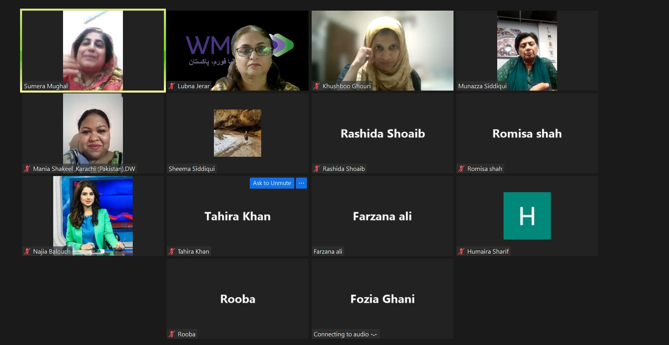
2024
IFJ has planned for this year’s activities with more gender training, a TOT, virtual campaigns, and gender mapping.
WMFP recently issued a statement on the murder of a woman journalist killed in Punjab.
WMFP is continuing with the fortnightly X spaces.

Slide 9
THANK YOU

